Slide 1


Goals of Bioinformatics
Bioinformatics aims to develop algorithms and statistical tools to extract meaningful insights from biological data. The field strives to improve our understanding of complex biological systems, such as genes and proteins, and to use this knowledge to benefit various areas, like healthcare, agriculture, and environmental sustainability.

Slide 2

Scope of Bioinformatics
1
Research and Development
The scope of bioinformatics extends to research and development in genomics, transcriptomics, proteomics, and metabolomics. It involves studying and interpreting large biological datasets, enabling the identification of genes, proteins, and pathways linked to diseases or environmental responses.
2
Data Analysis
Another significant aspect of bioinformatics scope is the analysis of biological data using computational tools and algorithms. This includes sequence alignment, homology modeling, and molecular dynamics simulations, all of which contribute to the understanding of biological processes.

Slide 3
Applications of Bioinformatics
Medical Diagnostics
Agricultural Advancements
Environmental Conservation
Bioinformatics plays a crucial role in medical diagnostics, aiding in the identification and understanding of genetic diseases and personalized medicine. It enables the analysis of patient's genetic data, leading to more precise treatments and disease management.
In agriculture, bioinformatics is applied to crop improvement, disease resistance, and the development of genetically modified organisms (GMOs) to enhance crop yield, nutritional quality, and resilience to environmental stress.
Bioinformatics tools are utilized to monitor and analyze biodiversity, ecosystem dynamics, and climate change impacts. This aids in creating strategies for conservation, sustainable resource management, and understanding the effects of environmental changes on species and habitats.

Slide 4

Limitations of Bioinformatics
1
Data Accuracy
2
Complexity of Biological Systems
3
Ethical Considerations
One of the limitations in bioinformatics is ensuring the accuracy of biological data. Factors such as sequencing errors, incomplete genome assemblies, and variations in experimental conditions can impact the reliability of results.
Issues related to privacy, consent, and the implications of genetic information in bioinformatics research and applications are important limitations that need to be taken into account for responsible and ethical practices.
The intricate nature of biological systems presents a challenge in accurately modeling and understanding their behavior. This complexity requires development of advanced computational models and analytical tools.

Slide 5


Bioinformatics in Genomics
Genome Sequencing
Genomic Data Analysis
Bioinformatics tools facilitate the assembly, alignment, and annotation of genomes, enabling the understanding of genetic variations, evolutionary relationships, and the identification of disease-causing mutations.
The analysis of large-scale genomic data using bioinformatics algorithms aids in characterizing gene function, regulatory elements, and pathways, contributing to advancements in personalized medicine and disease research.

Slide 6
Bioinformatics in Proteomics
Protein Identification
Structural Modeling
Bioinformatics tools are used for mass spectrometry data analysis to identify and characterize proteins, protein modifications, and protein-protein interactions essential for understanding cellular processes and disease mechanisms.
Structural bioinformatics techniques help in predicting the 3D structures of proteins, analyzing their functions, and designing drugs that target specific protein structures, leading to advancements in drug discovery and therapeutic interventions.

Slide 7
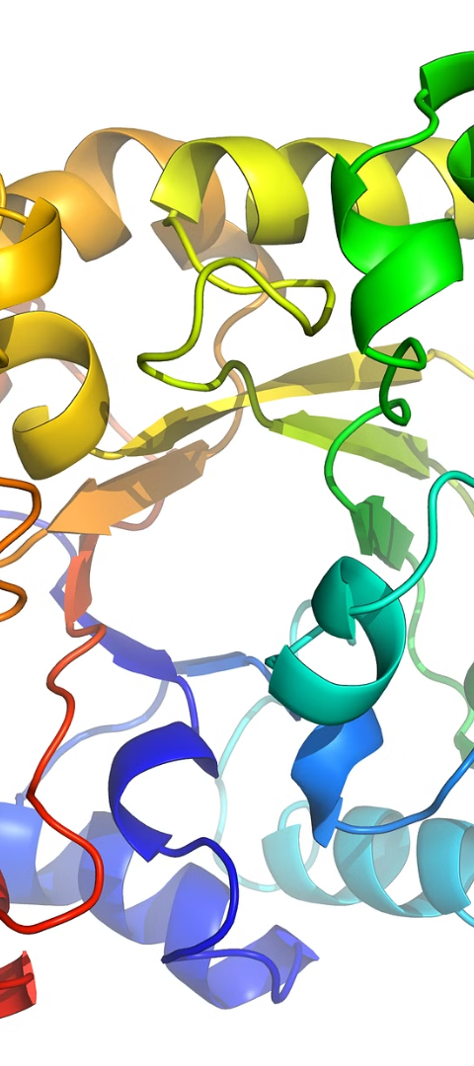


Bioinformatics in Structural Biology
Structure Prediction
Structural bioinformatics methods predict the 3D structure of proteins from their amino acid sequences, providing insights into their functions and interactions, aiding in drug design and understanding disease mechanisms.
Protein-Ligand Interactions
Bioinformatics tools analyze and predict the interactions between proteins and ligands, guiding the discovery and optimization of drug molecules, and facilitating the design of new therapeutic agents for various diseases.

Slide 8
Bioinformatics in Drug Discovery
Drug Target Identification
Bioinformatics aids in identifying potential targets for drug intervention and designing molecules that interact with disease-related proteins, enabling the development of novel therapeutics.
Pharmacogenomics
By integrating genomic and clinical data, bioinformatics contributes to understanding the inter-individual variations in drug responses, optimizing drug selection and dosing for personalized medicine.

Slide 9
Conclusion and Future Prospects
Advancements in Technology
Interdisciplinary Collaborations
The future of bioinformatics holds the promise of continued technological advancements, leading to more efficient data analysis, enhanced predictive modeling, and increased understanding of complex biological systems.
Interdisciplinary collaborations between bioinformaticians, biologists, clinicians, and computer scientists will foster innovations and solutions to complex biological and medical challenges.

